Slide 1

ANIL NEERUKONDA INSTITUTE OF TECHNOLOGY AND SCIENCES (A)
(Permanent Affiliation by Andhra University & Approved by AICTE)
Affiliated to AU, Approved by AICTE & Accredited by NAAC with A+ Grade, Accredited by NBA (B.Tech – ECE, EEE, CSE, IT, MECH, Civil & Chemical) Sangivalasa-531 162, Bheemunipatnam Mandal, Visakhapatnam District
| CAPSTONE PROJECT REVIEW — PHASE 1
DECENTRALIZED OFFLINE-FIRST CAMPUS MESH NETWORK
A Disaster-Resilient Peer-to-Peer Communication Architecture with Hybrid Cryptographic Trust and Role-Based QoS
TEAM - 12 CSD-B
PROJECT MEMBERS
Presented By Team 12:
- Darakesu Hemanth P(Lead)
Reg No: A23126551113
- Ruthvik Katcha
Reg No: A23126551119
- Kusa Madhuri
Reg No: A23126551098
- Garbhapu Sirisha
Reg No: A23126551084
Under the Guidance of:
Mrs. A. Bhagya Lakshmi
Assistant Professor, Dept. of CSD

Slide 2
ANIL NEERUKONDA INSTITUTE OF TECHNOLOGY & SCIENCES (ANITS) | DEPT. OF CSD TEAM 12 - DECENTRALIZED CAMPUS MESH NETWORK
AGENDA & PRESENTATION OUTLINE
TABLE OF CONTENTS
01. ABSTRACT
Academic context, motivation, and scope.
02. PROBLEM STATEMENT
Centralized SPOF, network blackouts, and broadcast storms.
03. INTRODUCTION
Campus dynamics, smartphone ubiquity, and offline necessity.
04. LITERATURE SURVEY
Systematic review of peer-reviewed IEEE research (2024-2018).
05. EXISTING SYSTEM & ARCHITECTURE
Critical audit of cloud platforms & failure points.
06. ARCHITECTURAL COMPARISON (FIG. 1)
Infrastructure-dependent vs. autonomous mesh.
07. DRAWBACKS OF EXISTING SYSTEM
Systemic collapse modes in campus disaster management.
08. PROPOSED SYSTEM NOVELTY
Strategic technical & operational advantages.
09. WORKFLOW ARCHITECTURE (FIG. 2)
Person-to-person smartphone mesh relay network.
10. SMARTPHONE ENGINE (FIG. 3)
User screen, smart traffic brain & dual radios.
11. OPERATIONAL LIFECYCLE (FIG. 4)
Pre-crisis setup, disaster survivability & metrics.
ANITS B.Tech Final Year Project Review (2025-2026) | Team 12 Page 2 of 15

Slide 3
ANIL NEERUKONDA INSTITUTE OF TECHNOLOGY & SCIENCES (ANITS) | DEPT. OF CSD TEAM 12 - DECENTRALIZED CAMPUS MESH NETWORK
SECTION 01 | EXECUTIVE RESEARCH SUMMARY
ABSTRACT
Academic Abstract:
Modern educational institutions rely entirely on centralized commercial cloud platforms and cellular backhauls for daily coordination. During natural disasters or infrastructure collapses, these centralized dependencies trigger immediate campus communication blackouts. While consumer ad-hoc mesh tools exist, they are unsuited for institutional environments—causing severe broadcast storms, offering zero cryptographic authority, and delaying life-saving emergency beacons in unprioritized queues. This research formulates the architecture for an offline-first, decentralized campus mesh network that leverages dual-radio BLE/Wi-Fi Aware transport, hybrid cryptographic trust, and role-based QoS emergency preemption to ensure guaranteed communication resilience.
CORE RESEARCH PREMISE
"Why do current communication tools leave campus communities helpless in crises?"
- Zero Infrastructure Fallback:
Commercial apps provide 0% local communication when internet towers lose power.
- The Academic Vacuum:
No existing system provides decentralized edge routing tailored for verified organizational roles.
- The Mesh Solution:
Empowering student smartphones to act as intelligent, battery-efficient multi-hop relays.
ANITS B.Tech Final Year Project Review (2025-2026) | Team 12 Page 3 of 15

Slide 4
ANIL NEERUKONDA INSTITUTE OF TECHNOLOGY & SCIENCES (ANITS) | DEPT. OF CSD TEAM 12 - DECENTRALIZED CAMPUS MESH NETWORK
SECTION 02 | FORMULATION OF SYSTEMIC DEFICITS
PROBLEM STATEMENT
Problem Formulation Statement:
Contemporary university campus communication systems rely completely on external commercial cellular networks and centralized cloud servers. When cyclones, power grid collapses, or physical cable cuts strike, this creates a catastrophic single point of failure that paralyzes administrative coordination. Meanwhile, attempting to deploy standard consumer ad-hoc mesh tools introduces severe operational failures: unmanaged multi-hop flooding triggers channel contention dropping over 70% of packets, the complete lack of cryptographic role verification enables panic and unverified rumors, and unprioritized FIFO queuing stalls life-critical emergency SOS alerts behind casual chat.
CRITICAL FAILURE SUMMARY
WHY CONTEMPORARY APPS FAIL CAMPUS CRISES:
- [!] Total Cloud Lock-in:
Zero offline routing across local smartphone radios.
- [!] Packet Collapse:
Unregulated flooding destroys wireless throughput in crowded corridors.
- [!] Spoofing Vulnerability:
Zero offline public key verification allows rogue fake alerts.
- [!] FIFO Queue Stalls:
Medical SOS packets delayed with zero emergency preemption.
ANITS B.Tech Final Year Project Review (2025-2026) | Team 12 Page 4 of 15

Slide 5
ANIL NEERUKONDA INSTITUTE OF TECHNOLOGY & SCIENCES (ANITS) | DEPT. OF CSD TEAM 12 - DECENTRALIZED CAMPUS MESH NETWORK
SECTION 03 | CAMPUS CONTEXT & NETWORK PARADIGMS
INTRODUCTION
CAMPUS SCALE & OPPORTUNITY
THE CAMPUS ECOSYSTEM:
- Dense Footprint:
5,000+ mobile nodes within an enclosed 50-acre perimeter.
- Latent Mesh Fabric:
Thousands of BLE and Wi-Fi transceivers active in student pockets.
- The Opportunity:
Creating an autonomous local network without telecom infrastructure or external ISP costs.
• Dense Micro-Community Footprint:
Educational campuses concentrate 5,000+ students and staff across 50 acres, requiring rapid and autonomous information sharing.
• Single Point of Failure Vulnerability:
Routine reliance on external cellular towers (4G/5G) and Wi-Fi APs causes total network blackout during power grid cuts or cyclones.
• Latent Smartphone Transceiver Potential:
Student smartphones already possess multi-standard radios (BLE, Wi-Fi Aware) capable of direct device-to-device communication.
• The Missing Campus Routing Fabric:
Current OS and mobile apps lack decentralized edge routing, institutional role verification, and life-critical emergency QoS.
ANITS B.Tech Final Year Project Review (2025-2026) | Team 12 Page 5 of 15

Slide 6
ANIL NEERUKONDA INSTITUTE OF TECHNOLOGY & SCIENCES (ANITS) | DEPT. OF CSD | TEAM 12
SURVEYED RESEARCH PILLARS
- 1. Reliable BLE Mesh Surge Routing
Law et al. (IEEE HealthCom, 2024)
- 2. Opportunistic Disaster Routing
Dalal et al. (IEEE Access, 2022)
- 3. Dynamic Mesh Congestion Control
Al-Kashoash et al. (IEEE IoT Journal, 2019)
- 4. Delay-Tolerant Mobile Social Nets
Asghar et al. (IEEE Access, 2018)
| SECTION 04
LITERATURE SURVEY
Systematic review of foundational IEEE research in ad-hoc mesh routing, BLE multi-hop reliability, opportunistic DTNs, and congestion mitigation (2024 to 2018 in descending order).
ANITS B.Tech Final Year Project Review (2025-2026) | Team 12 Page 6 of 15

Slide 7
ANIL NEERUKONDA INSTITUTE OF TECHNOLOGY & SCIENCES (ANITS) | DEPT. OF CSD TEAM 12 - DECENTRALIZED CAMPUS MESH NETWORK
SECTION 04 | PEER-REVIEWED RESEARCH ANALYSIS (DESCENDING ORDER)
TABLE 1: LITERATURE SURVEY SUMMARY
Author & Year (Click to Open) | Publication Venue & Core Methodology | Key Findings & Systemic Strengths | Identified Gaps & Critical Drawbacks
Law et al. (2024) [Open IEEE Paper] | IEEE HealthCom (2024) • BLE mesh surge networking • CoAP-assisted fog caching | • Proved edge caching prevents multi-hop BLE buffer drops in high-density surge spaces. | • Lacks dynamic Wi-Fi Aware upgrade • Zero institutional PKI authentication
Dalal et al. (2022) [Open IEEE Paper] | IEEE Access (2022) • Systematic survey of Opportunistic Routing (OR) • Candidate forwarder selection | • Classified energy-aware candidate forwarding to bypass routing voids in disaster zones. | • Assumes homogeneous peer trust • No role-based QoS emergency preemption
Al-Kashoash et al. (2019) [Open IEEE Paper] | IEEE IoT Journal (2019) • Congestion & buffer management • Dynamic threshold control | • Proved adaptive buffer thresholds prevent packet drops during heavy multi-hop bursts. | • Evaluated only on static sensors • Lacks mobile discovery & campus hierarchy
Asghar et al. (2018) [Open IEEE Paper] | IEEE Access (2018) • Delay-Tolerant Networks (DTN) • Store-carry-forward routing | • Verified multi-hop message delivery across mobile nodes during total grid blackouts. | • Relies on random opportunistic encounters • Lacks cryptographic verification against spoofing
ANITS B.Tech Final Year Project Review (2025-2026) | Team 12 Page 7 of 15

Slide 8
ANIL NEERUKONDA INSTITUTE OF TECHNOLOGY & SCIENCES (ANITS) | DEPT. OF CSD TEAM 12 - DECENTRALIZED CAMPUS MESH NETWORK
SECTION 05 | CRITICAL AUDIT OF CONTEMPORARY SOLUTIONS
EXISTING SYSTEM: DETAILED PROJECT ANALYSIS
01. Commercial Centralized Platforms (WhatsApp, Telegram, College ERP):
• Architecture: Client-server routing dependent on remote cloud servers (AWS/Azure) and 4G/5G cell towers.
• Crisis Deficit: 100% external dependency. When cyclones or power failures hit, total campus blackout occurs with zero offline relay capability.
02. Consumer Ad-Hoc Mesh Apps (Bridgefy, FireChat, Briar):
• Architecture: Multi-hop peer-to-peer flooding across mobile phones over standard BLE or Wi-Fi Direct.
• Crisis Deficit: Blind flooding causes crippling broadcast storms (>70% packet drop in crowds); lacks institutional roles and offline authentication.
03. Specialized Hardware DTN Solutions (The Serval Project, goTenna Mesh):
• Architecture: Relies on external proprietary VHF/UHF radio dongles or rooted Android firmware.
• Crisis Deficit: Cost-prohibitive for thousands of students; very low throughput (<5 kbps) and incompatible with standard smartphones.
THE UNMET CAMPUS VACUUM
"NO EXISTING APP MEETS CAMPUS NEEDS"
- Market Dichotomy:
Apps are either 100% cloud-dependent (WhatsApp) or unauthenticated civilian toys (Bridgefy).
- Zero Administrative Trust:
No existing offline app can cryptographically prove faculty or emergency staff identity.
- Packet Collapse:
Unregulated flooding guarantees channel congestion in student hostels and lecture halls.
ANITS B.Tech Final Year Project Review (2025-2026) | Team 12 Page 8 of 15

Slide 9
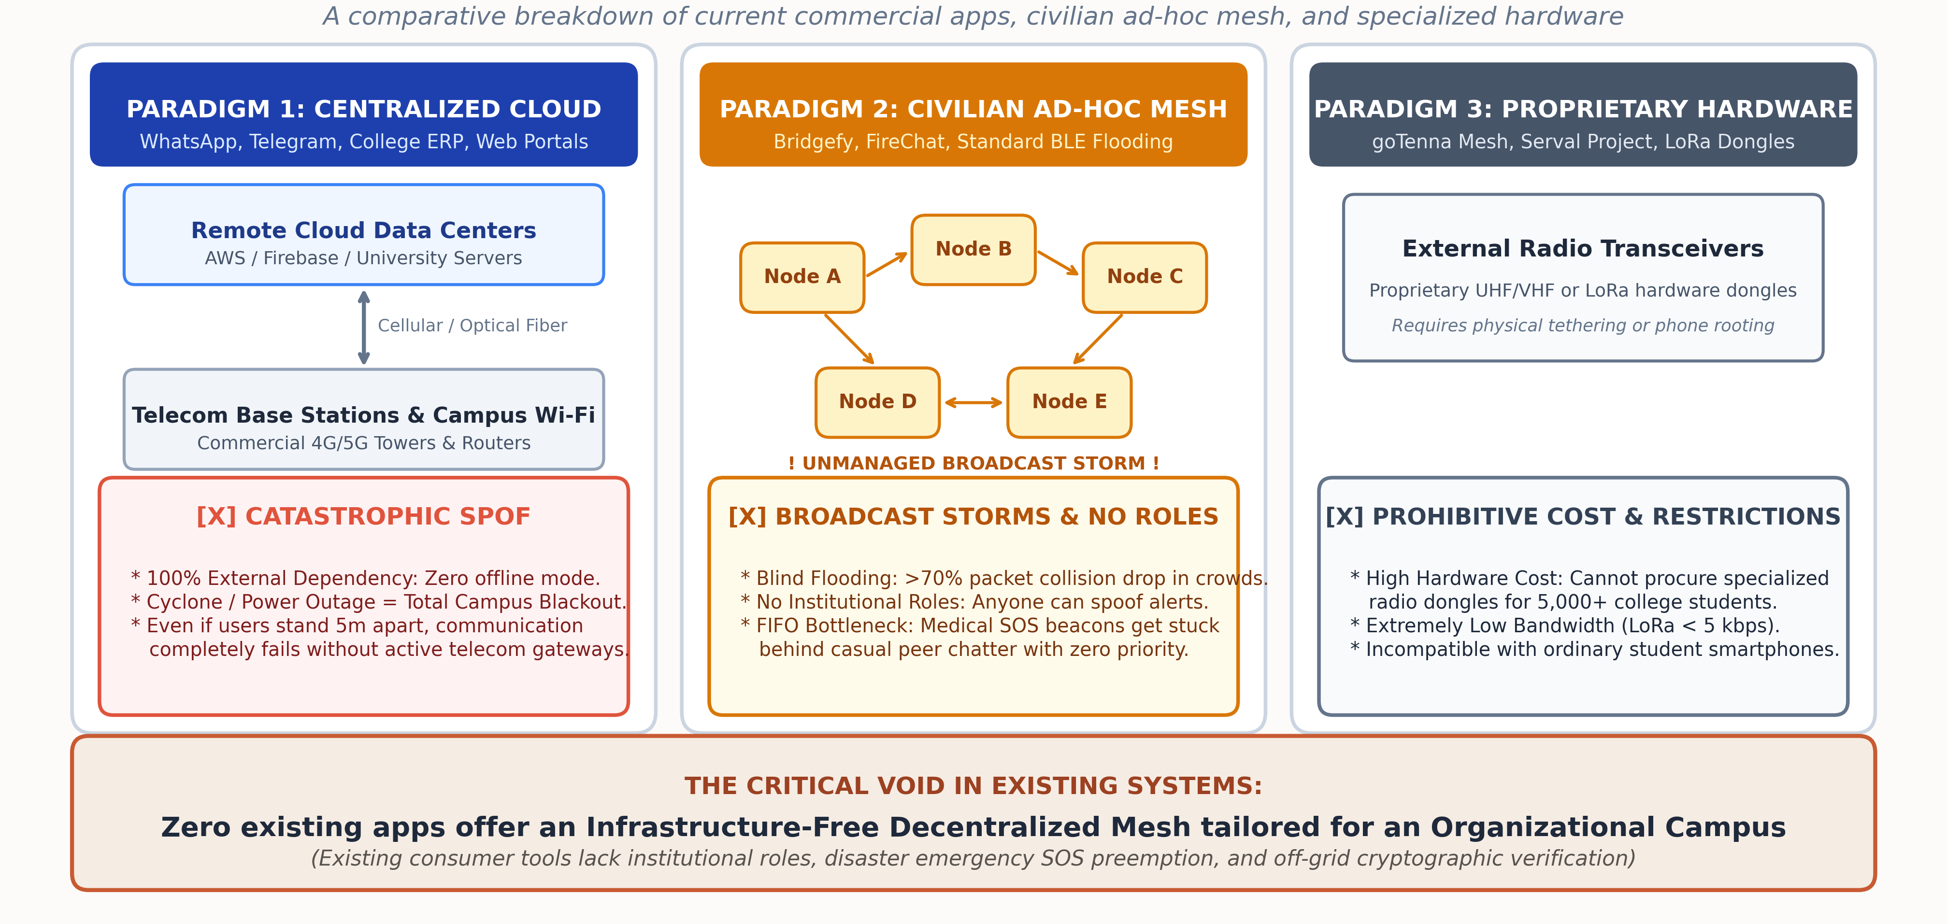
ANIL NEERUKONDA INSTITUTE OF TECHNOLOGY & SCIENCES (ANITS) | DEPT. OF CSD TEAM 12 - DECENTRALIZED CAMPUS MESH NETWORK
SECTION 06 | FIG. 1: ARCHITECTURAL COMPARISON
EXISTING SYSTEM ARCHITECTURE & FAILURE MODES
ANITS B.Tech Final Year Project Review (2025-2026) | Team 12 Page 9 of 15

Slide 10
ANIL NEERUKONDA INSTITUTE OF TECHNOLOGY & SCIENCES (ANITS) | DEPT. OF CSD TEAM 12 - DECENTRALIZED CAMPUS MESH NETWORK
SECTION 07 | SYSTEMIC BREAKDOWN IN CAMPUS CRISES
DRAWBACKS OF EXISTING SYSTEM
01. Catastrophic Single Point of Failure (SPOF):
Total dependence on external cellular towers and power grids causes instant campus communication collapse during disasters.
02. Lack of Campus Disaster Management & Evacuation Logic:
Zero native support for offline triage protocols, emergency muster verification, or localized evacuation directives.
03. Devastating Broadcast Storms in Dense Student Clusters:
Blind peer-to-peer rebroadcasts generate exponential radio packet collisions (>70% packet drop) in crowded halls.
04. Complete Absence of Organizational Role Hierarchy:
Anonymous peer networking allows unauthenticated users to broadcast panic-inducing rumors with no faculty verification.
05. Best-Effort FIFO Latency Delaying Life-Saving SOS:
Unprioritized first-in, first-out buffers trap critical medical distress beacons behind casual peer chit-chat.
06. Zero-Trust Security Vulnerabilities & Severe Battery Drain:
Cleartext multi-hop relaying invites packet interception, while unthrottled radio scanning drains batteries in 2-3 hours.
CRITICAL AUDIT VERDICT
"CURRENT TOOLS ARE INSUFFICIENT"
- [X] Centralized Apps:
Fail completely when the physical electrical/cellular grid loses power.
- [X] Civilian Ad-Hoc Apps:
Fail completely in dense student populations due to RF broadcast storms.
- [X] Organizational Need:
Campuses require both infrastructure independence AND strict institutional authority.
ANITS B.Tech Final Year Project Review (2025-2026) | Team 12 Page 10 of 15

Slide 11
ANIL NEERUKONDA INSTITUTE OF TECHNOLOGY & SCIENCES (ANITS) | DEPT. OF CSD TEAM 12 - DECENTRALIZED CAMPUS MESH NETWORK
SECTION 08 | NOVEL CAMPUS ARCHITECTURE & SOLUTIONS
PROPOSED SYSTEM: OVERCOMING EXISTING LIMITATIONS
01. First-Ever Organizational Decentralized Mesh Architecture:
• Bridges the market vacuum with the first offline fabric designed specifically for verified university campus roles and institutional hierarchy.
02. 100% Infrastructure-Independent Edge Communication (Zero SPOF):
• Autonomous device-to-device multi-hop routing operates over student smartphones, surviving complete external electrical and cellular collapses.
03. Dual-Radio Energy Synergy (BLE Discovery + Wi-Fi Aware Transport):
• Low-power BLE maintains continuous background neighbor discovery, elevating dynamically to high-speed Wi-Fi Aware (NAN) for data payloads.
04. Hybrid Cloud Sync & Offline Cryptographic Trust (PKI):
• Periodically syncs campus public keys to local SQLite cache when online; enables 100% offline verification of faculty announcements via Ed25519 signatures.
05. Strict Role-Based QoS & Broadcast Storm Suppression:
• High-priority queues ensure life-saving SOS alerts preempt casual traffic; dynamic TTL limits, bloom filters, and sequence caching eliminate storm collisions.
PROJECT NOVELTY & ADVANTAGE
"BRIDGING THE ACADEMIC GAP"
- [✓] Organizational Mesh:
First decentralized mesh built for institutional campus roles.
- [✓] Zero Hardware Cost:
Runs on standard Android & iOS smartphones already in student pockets.
- [✓] Guaranteed Emergency QoS:
Life-saving SOS alerts always preempt casual student chatter.
- [✓] Total Disaster Resilience:
Functions indefinitely when external cellular towers and power collapse.
ANITS B.Tech Final Year Project Review (2025-2026) | Team 12 Page 11 of 15

Slide 12
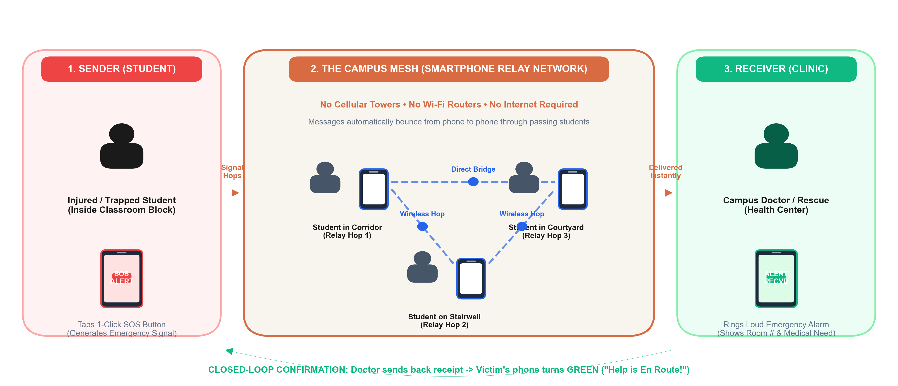
ANIL NEERUKONDA INSTITUTE OF TECHNOLOGY & SCIENCES (ANITS) | DEPT. OF CSD TEAM 12 - DECENTRALIZED CAMPUS MESH NETWORK
SECTION 09 | FIG. 2: WORKFLOW ARCHITECTURE: PERSON-TO-PERSON MESH FLOW
CAMPUS DISASTER SOS: HUMAN-TO-HUMAN SMARTPHONE RELAY
ANITS B.Tech Final Year Project Review (2025-2026) | Team 12 Page 12 of 15

Slide 13
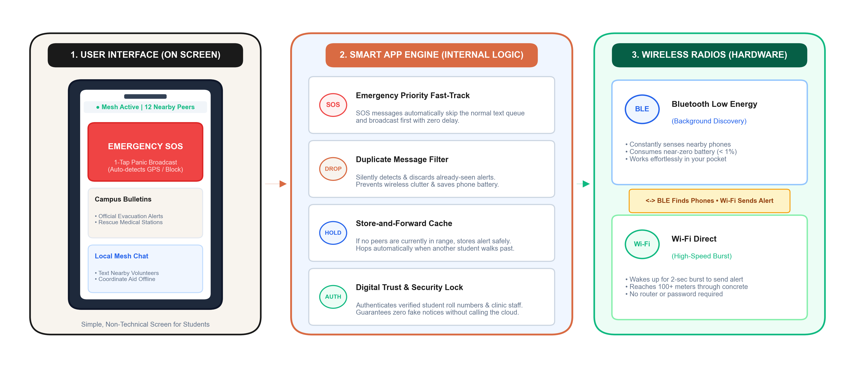
ANIL NEERUKONDA INSTITUTE OF TECHNOLOGY & SCIENCES (ANITS) | DEPT. OF CSD TEAM 12 - DECENTRALIZED CAMPUS MESH NETWORK
SECTION 10 | FIG. 3: SMARTPHONE ENGINE: APP ARCHITECTURE & RADIOS
WHAT HAPPENS INSIDE THE PHONE: USER SCREEN, SMART BRAIN & RADIOS
ANITS B.Tech Final Year Project Review (2025-2026) | Team 12 Page 13 of 15

Slide 14
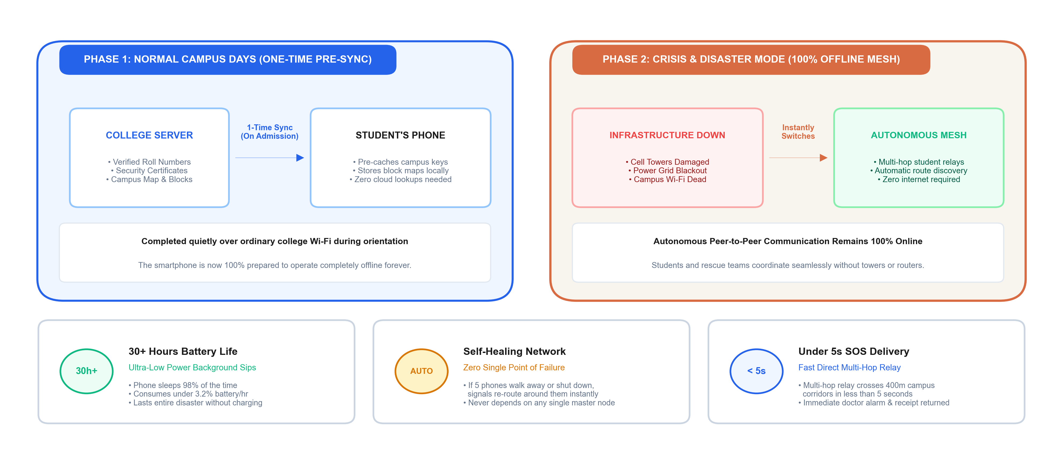
ANIL NEERUKONDA INSTITUTE OF TECHNOLOGY & SCIENCES (ANITS) | DEPT. OF CSD TEAM 12 - DECENTRALIZED CAMPUS MESH NETWORK
SECTION 11 | FIG. 4: OPERATIONAL LIFECYCLE & CORE PERFORMANCE GUARANTEES
HOW THE SYSTEM OPERATES: PRE-CRISIS PREPARATION & DISASTER SURVIVABILITY
ANITS B.Tech Final Year Project Review (2025-2026) | Team 12 Page 14 of 15

Slide 15
THANKYOU

